Slide 1
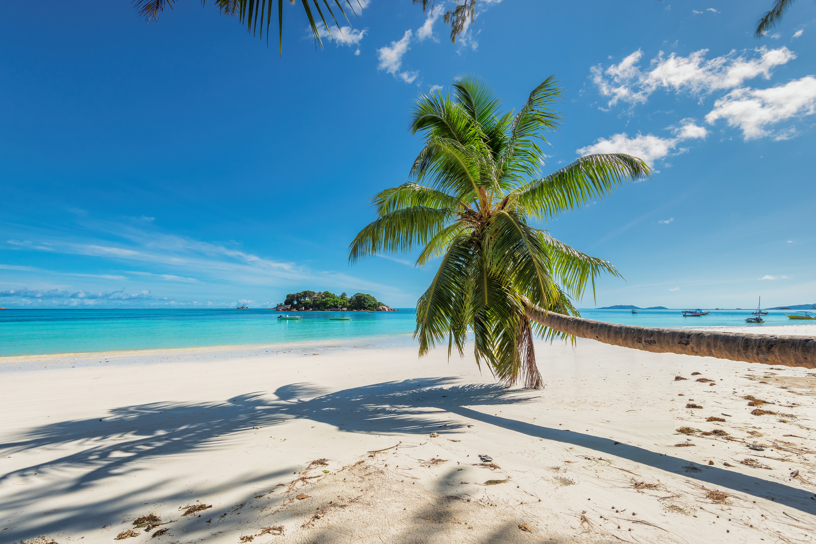
John & Erica Lopez
“You’re my everything”
September 20th – 22nd 2019

Slide 2
Andy & Suzi Gillen
“You’re my everything”
September 20th – 22nd 2019

Slide 3
Rudy & Emily Garza
“You’re my everything”
September 20th – 22nd 2019

Slide 4
Dyron & Christina Walls
“You’re my everything”
September 20th – 22nd 2019

Slide 5
Tom & Didi Kolkebeck
“You’re my everything”
September 20th – 22nd 2019

Slide 6
Jacob & Audrey Flach
“You’re my everything”
September 20th – 22nd 2019

Slide 7
Lee & Letty Spain
“You’re my everything”
September 20th – 22nd 2019

Slide 8
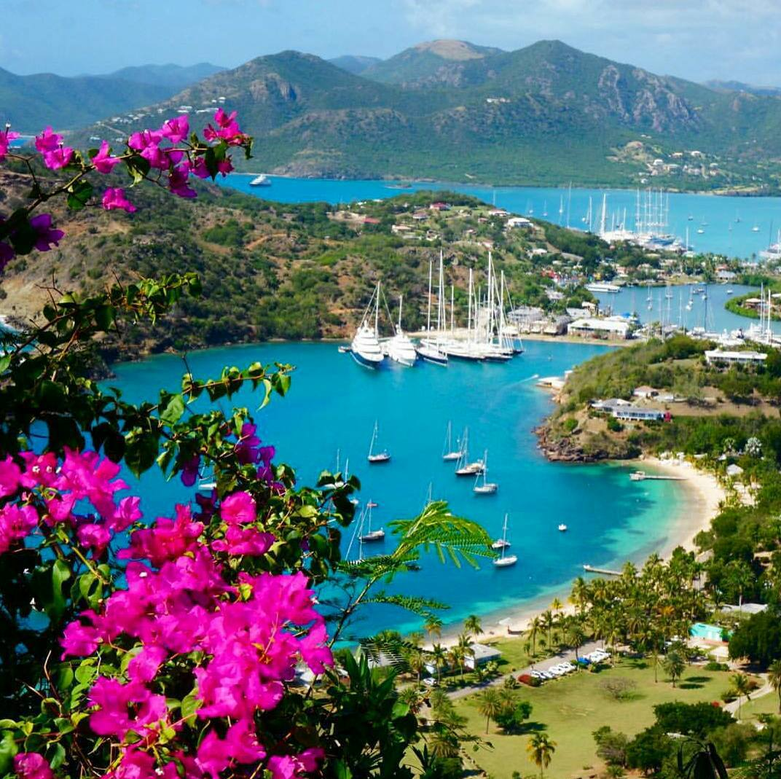
Tom & Nancy Guajardo
“You’re my everything”
September 20th – 22nd 2019

Slide 9
Charles & Sandi Dudley
“You’re my everything”
September 20th – 22nd 2019

Slide 10
Brian & Dina Murphy
“You’re my everything”
September 20th – 22nd 2019

Slide 11
Jim & Dulce Flores
“You’re my everything”
September 20th – 22nd 2019

Slide 12
Eric & Brenda King
“You’re my everything”
September 20th – 22nd 2019

Slide 13
Evan & Theresa Wittig
“You’re my everything”
September 20th – 22nd 2019

Slide 14
Daniel & Gladys Vela
“You’re my everything”
September 20th – 22nd 2019

Slide 15
Eddy Anzueto & Bruna Spengler-Anzueto
“You’re my everything”
September 20th – 22nd 2019

Slide 16
James & Hayley Hoelscher
“You’re my everything”
September 20th – 22nd 2019

Slide 17
George & Maria Torres
“You’re my everything”
September 20th – 22nd 2019

Slide 18
Steve & Trudy Borrego
“You’re my everything”
September 20th – 22nd 2019

Slide 19
AB & Jill Cruz
“You’re my everything”
September 20th – 22nd 2019

Slide 20
Dennis & Christine Watters
“You’re my everything”
September 20th – 22nd 2019

Slide 21
Rico & Karen Barreto
“You’re my everything”
September 20th – 22nd 2019

Slide 22
Jon & Romona Disrud
“You’re my everything”
September 20th – 22nd 2019

Slide 23
Alex & Cindy Castillo
“You’re my everything”
September 20th – 22nd 2019

Slide 24
Cesar & Maria Abinsay
“You’re my everything”
September 20th – 22nd 2019

Slide 25
Steve & Emily Galvan
“You’re my everything”
September 20th – 22nd 2019

Slide 26
Adrian & Adriana Sotelo
“You’re my everything”
September 20th – 22nd 2019

Slide 27
Sam & Felisha Sanchez
“You’re my everything ”
September 20th – 22nd 2019

Slide 28
Lennard & Claudia Perez
“You’re my everything”
September 20th - 22nd 2019

Slide 29
Carlos & Karina Lopez
“You’re my everything”
September 20th – 22nd 2019

Slide 30
Arthur & Thelma Hernandez
“You’re my everything”
September 20th – 22nd 2019

Slide 31
Art & Tess Jackson
“You’re my everything”
September 20th – 22nd 2019

Slide 32
Oscar & Letty Montemayor
“You’re my everything”
September 20th – 22nd 2019

Slide 33
Jeremy & Valerie Logsdon
“You’re my everything”
September 20th – 22nd 2019

Slide 34
Scott & Dana Villareal
“You’re my everything”
September 20th – 22nd 2019

Slide 35
Dan & Diane Bridon
“you’re my everything”
September 20th – 22nd 2019

Slide 36
“You’re my everything”
September 20th – 22nd 2019

